Slide 1
Skills for Success
What They Are and Why They Are Important
An Introduction for Junior High & Middle School Students

Slide 2
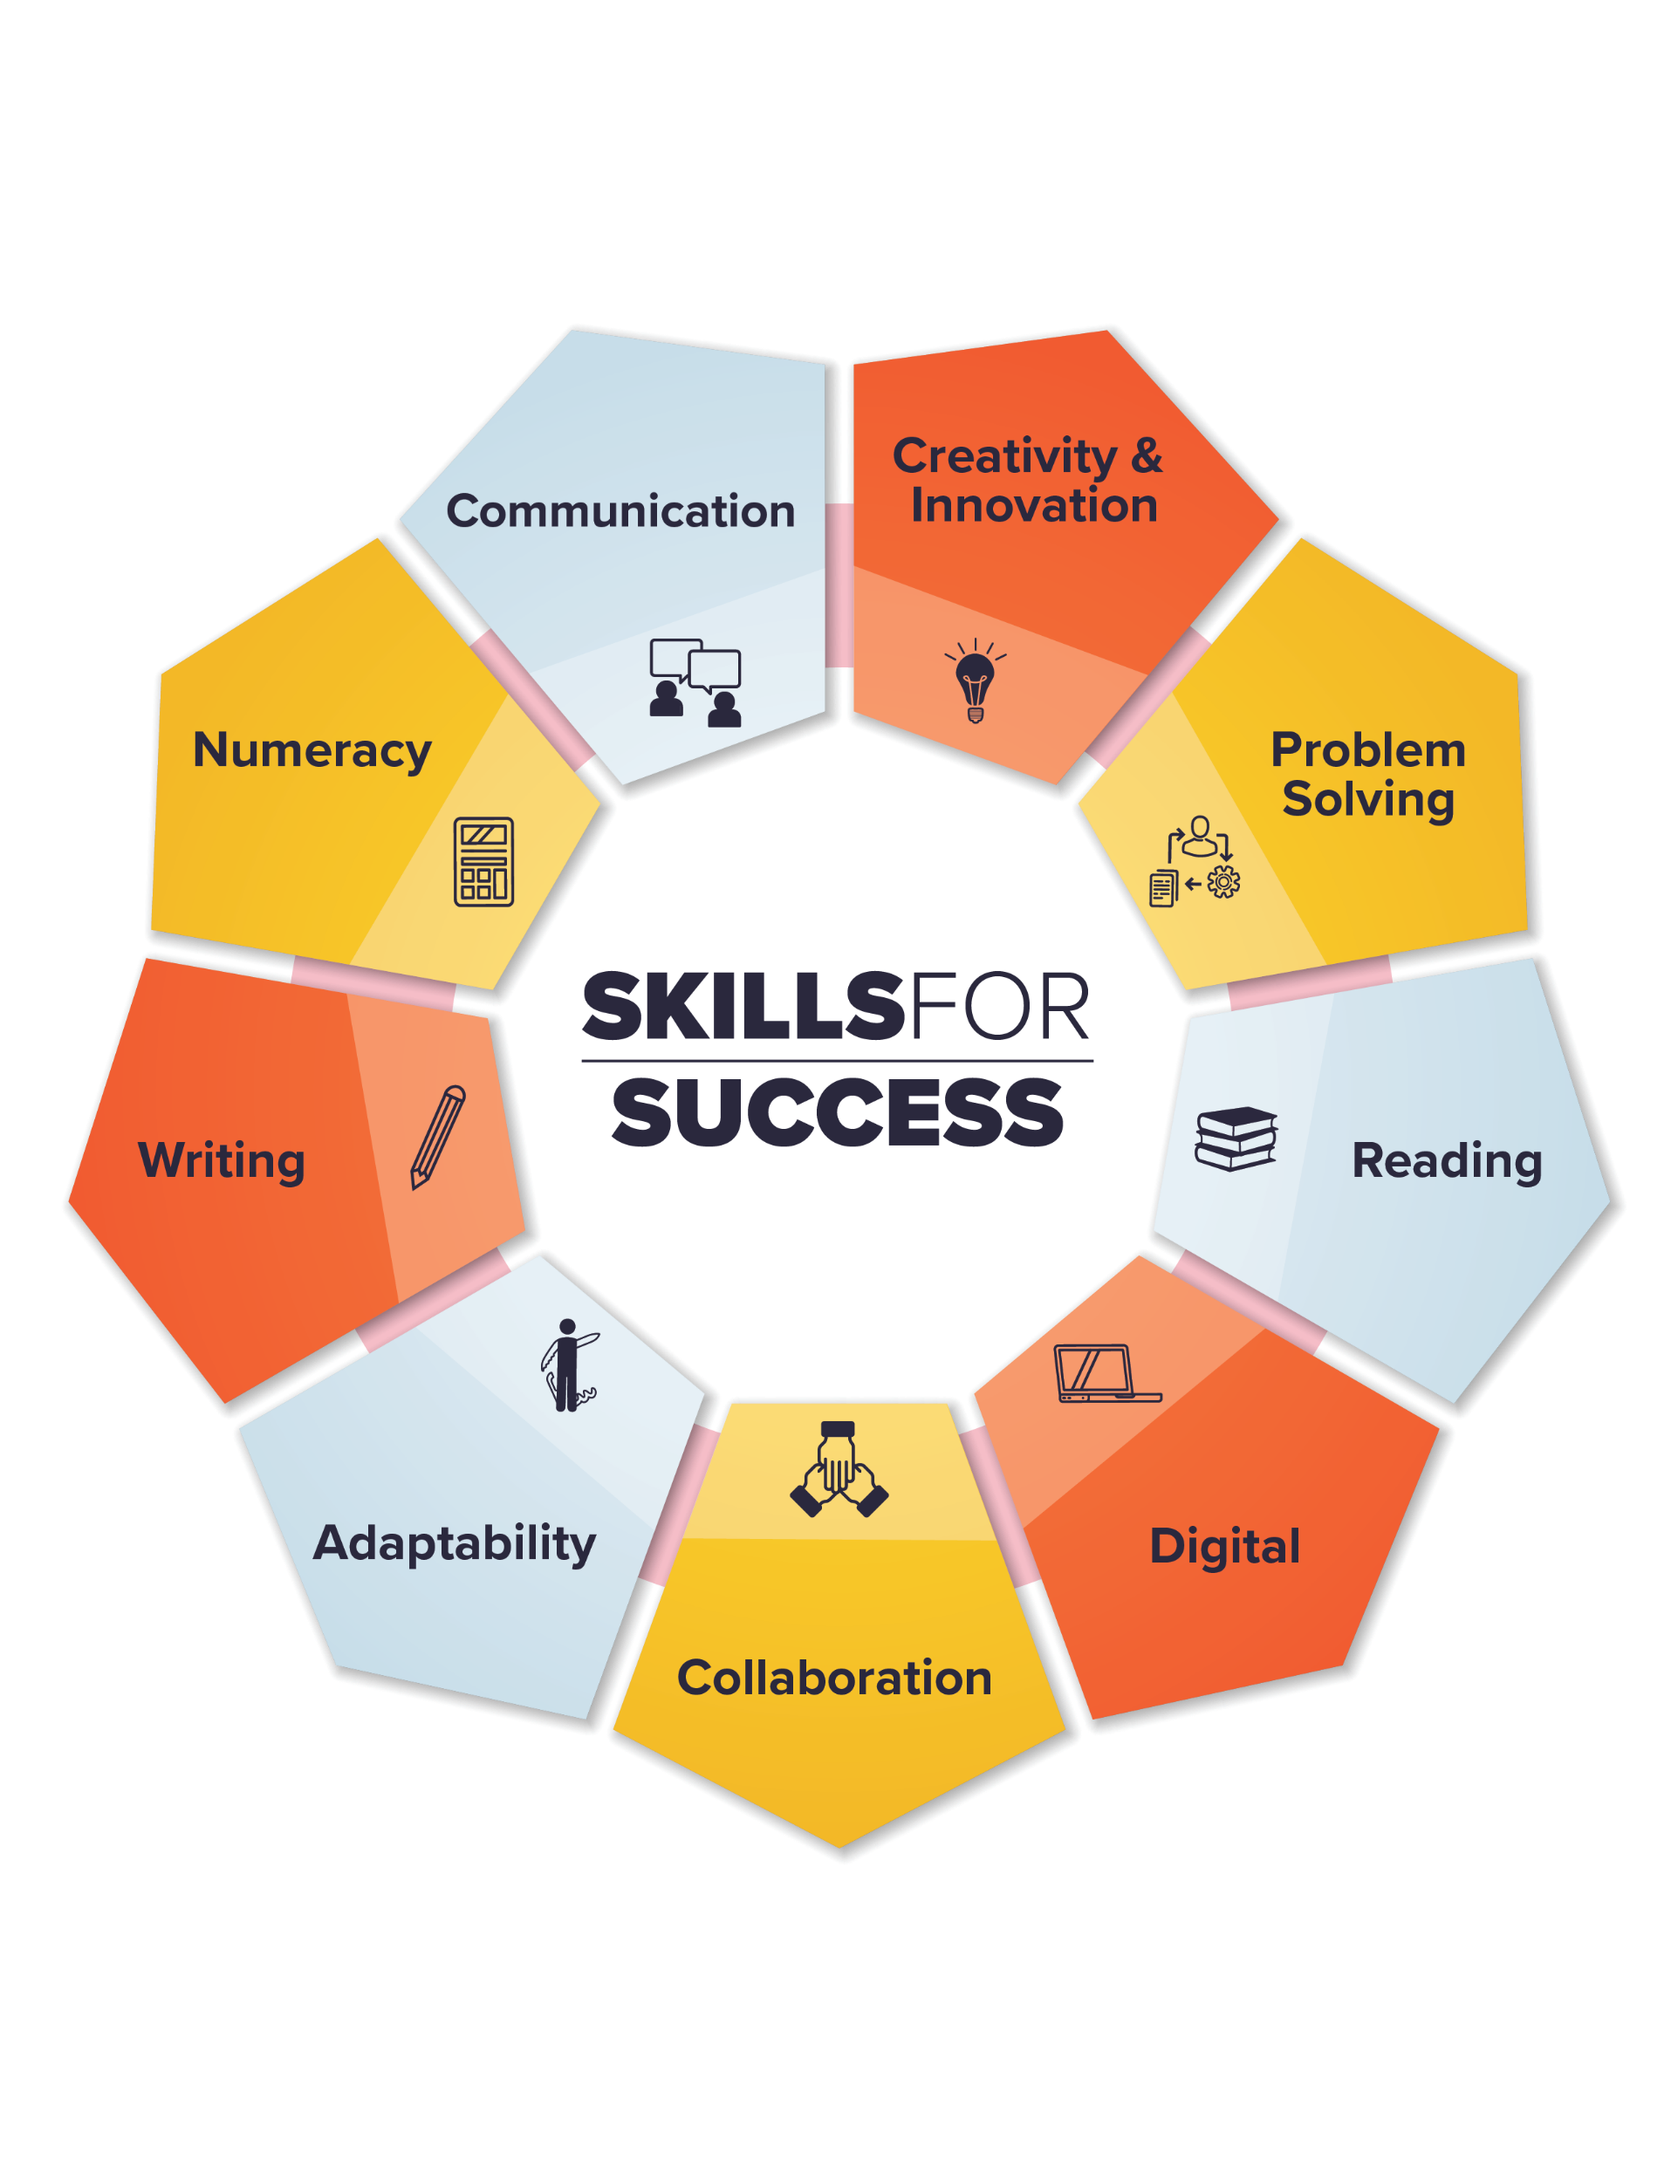
The Skills for Success Framework
There are 9 Skills in the Skills for Success framework and they apply to everyone!
Watch this video to learn more.
Image retrieved with permission February 2022 https://www.canada.ca/en/services/jobs/training/initiatives/skills-success/understanding-individuals.html#h2.1

Slide 3
Who Can Benefit from The Skills for Success?
Understanding of these skills and how they can be used are of importance to:
Communities | Families | Training Providers
Educators | Governments | Workers
Employers | Job Seekers
Notes:
Teachers can support students in brainstorming ways these skills would be important to each of the bulleted groups found on this slide. Is there a group of people that could be included that is not found on the slide?

Slide 4
What Is the Purpose?
To help provide Canadians with everyday skills needed for work, learning and life
To raise awareness on the importance of continuously learning particularly about improving skills to help them succeed in today’s workplace and to succeed in the workplace of tomorrow
To emphasize how these skills are needed for building other skills and knowledge while also supporting effective social interaction.
To show how these skills overlap and interact with each other, and with other technical and life skills.
To share how they are inclusive and can be adapted to different contexts.

Slide 5
The 9 Skills
Adaptability | Creativity & innovation | Problem Solving
Collaboration | Digital | Reading
Communication | Numeracy | Writing
Notes:
Link to site where videos on each of the skills can be found: https://www.canada.ca/en/services/jobs/training/initiatives/skills-success/video.html
Each of the skills has been individually linked

Slide 6
Why Are They Important for Junior High & Middle School Students To Know About?
Notes:
Ask students for their input on why they are important to who they are as learners? Who they are as future employees? Who they are as citizens?
To help them see who they are as learners
To help them develop or improve upon skills that could strengthen them as learners
To help them see how the skills they are developing in school will follow them each year as they move between grades
To help them secure part time jobs
To help them understand their roles and apply their skills at home, in the community
To help them in setting goals for their future
To help them match careers to their skills
To help them succeed at post-secondary or in training programs
To help them understand workplace expectations and succeed when they enter the workplace

